Slide 1

Sequential Sytems. Part 1: Memory Elements. Registers. Counters (Lab. 3)
IAX 0600 Digital Systems Design
Alexander Sudnitson
Tallinn University of Technology

Slide 2
Sequential systems
Digital systems can be classified as either combinational or sequential.
As we have seen, a combinational system’s outputs are completely determined by its present input values.
In contrast, a sequential system’s outputs depend not only on its present input values, but also on its past history of input values. This history is represented by the binary present state value stored in memory elements in the sequential system. Accordingly, the output of a sequential system is a function of both its present input values and present state. A sequential system’s outputs are a function of both its present input value and past history of its input values.

Slide 3
Memory elemetns
A single memory element is, by itself, a simple sequential system that stores 1 bit of information. A memory element has two stable states, corresponding to its storing either a 0 or a 1.
When a memory element stores a 0, it is said to be clear. When it stores a 1, it is said to be set.
A memory element’s output indicates its present state.
State: all the information about a circuit necessary to explain its future behavior

Slide 4
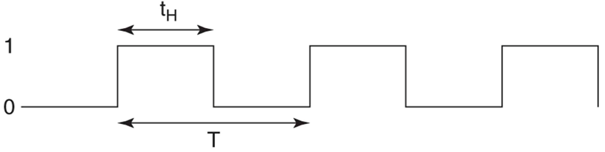
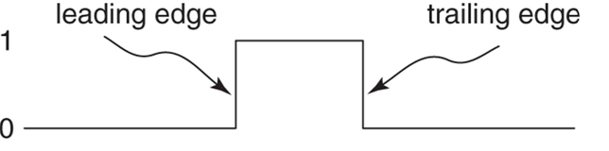
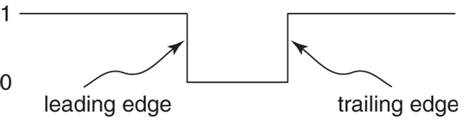
Clock
A clock signal is a train (sequence) of pulses used as a timing signal.
The amount of time a periodic signal is 1 during its period (tH) is constant. This time is the clock’s width. The ratio of the clock’s width to its period (tH / T), expressed as a percent, is its duty cycle.

Slide 5
Latch versus flip-flop
A latch’s state can be changed by its synchronous inputs during the entire time its clock is asserted.
Synchronous inputs to a flip-flop are sampled only at a triggering clock edge. Thus, the flip-flop’s output can change value in response to synchronous inputs only at a triggering clock edge.

Slide 6
Latch versus flip-flop
A memory element is categorized as either a latch or a flip-flop, based on to which characteristic of its clock signal it is sensitive.
The primary difference between the two is that a latch’s state can be changed by its synchronous inputs during the entire time its clock is asserted. In contrast, a flip-flop’s state can be changed by its synchronous inputs only at the edge of a clock pulse. Flip-flops are used much more extensively as
memory elements in designs than are latches.

Slide 7
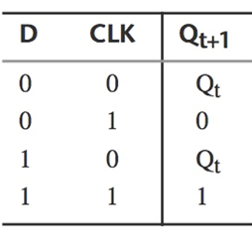
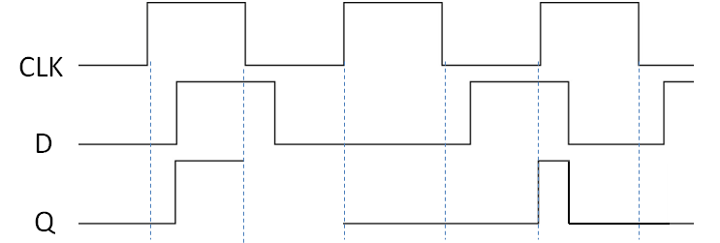
Positive-level latch
When a positive-level D latch’s clock input (CLK) is a 1, its Q output value follows its D input value. Under this clock condition, any change at D appears at Q. The input data is said to “flow through” to the output, and the latch is termed transparent. That is, the output tracks the input.

Slide 8
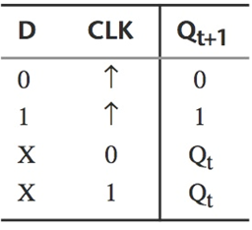
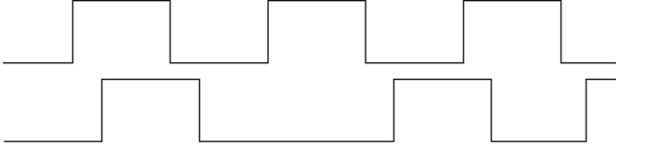
Positive edge triggered flip-flop
A D flip-flop is an positive edge-triggered memory element that transfers the value on its D input to its Q output when a triggering edge occurs at its clock input. This output value is stored until the next triggering clock edge. Thus, a D flip-flop can change its state only once during a clock cycle.
CLK
D
Q

Slide 9
Explicit and implicit description of memory elemetns
Using VHDL, a memory element can be described either explicitly or implicitly.
An explicit description corresponds to the instantiation of a memory element component.
In contrast, an implicit description uses a programming style that describes behavior corresponding to that of a memory element. In this later case, a synthesizer infers that
a memory element is needed to achieve the described behavior.

Slide 10
Explicit and implicit description of memory elemetns
We can cause a memory element to be synthesized by writing code that is recognized as implying the need for a memory element. The technique used by a synthesizer to determine, from its interpretation of the VHDL code, when a latch must be synthesized is called latch inference.
For example, an if statement whose if clause contains an asynchronous assignment to a signal, but which has no terminating else clause, causes a synthesizer to infer that a latch is required. A latch is required because, when the condition is not true, the signal is not assigned a new value. Therefore, the signal must retain its previous value, necessitating a latch.
The sensitivity list must contain all of the signals read within the process.

Slide 11
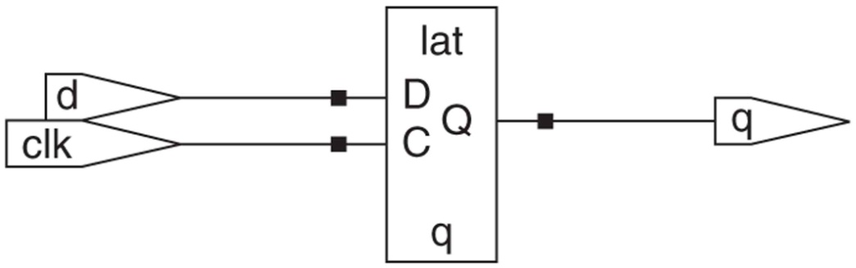
D latch description
library ieee; use ieee.std_logic_1164.all;
entity d_latch is
port (d: in std_logic; clk: in std_logic;
q: out std_logic );
end d_latch;
architecture behavioral of d_latch is
begin
process (d, clk)
begin
if clk = '1' then
q <= d;
end if;
end process;
end behavioral;
The if statement has no terminating else clause
Latch inferred by synthesizer

Slide 12
Equivalent descriptions
process (d, clk)
begin
if clk = '1' then
q <= d;
else
null;
end if;
end process;
process (d, clk)
begin
if clk = '1' then
q <= d;
end if;
end process;
q <= d when clk = '1‘;
q <= d when clk = '1' else
unaffected;
A concurrent signal assignment statement can also be used to infer a latch (instead of process statement).

Slide 13
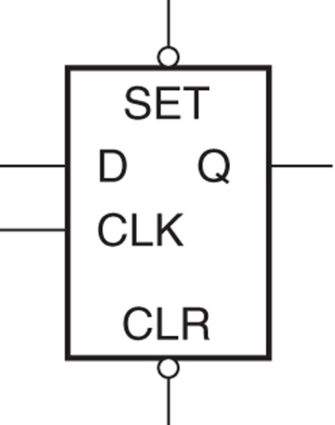
D latch with asynchronous set and clear inputs
entity d_latch is
port (d, clk, set_bar, clear_bar : in std_logic; q: out std_logic);
end d_latch;
architecture behavioral of d_latch is
begin
process (d, clk, set_bar, clear_bar)
begin
if set_bar = '0' then q <= '1'; -- asynchronous set
elsif clear_bar = '0' then q <= '0'; -- asynchronous clear
elsif clk = '1' then q <= d; -- d latch
end if;
end process;
end behavioral;
Since all of the latch’s inputs are in the process’s sensitivity list, an event on any input causes the process to execute.

Slide 14
Detecting clock edges
There are several boolean type expressions that can be used to describe a condition that corresponds to the occurrence of a clock edge. We assume that a clock signal is named clk.
Three expressions for a positive clock-edge condition
(1) clk'event and clk = '1‘
The first subexpression is an event attribute (is true when there is a change in the associated signal’s value).
(2) not clk‘stable and clk = '1‘
not clk‘stable is true when clk is not stable during a simulation cycle, which is equivalent to an event on clk.
(3) rising_edge (clk)
The function rising_edge, defined in package STD_LOGIC_1164. This function is true only if clk makes a transition from '0' to '1'. It is not true for a transition from any other value to a '1'.

Slide 15
Detecting clock edges
Three expressions for a negative clock-edge condition
(1) clk'event and clk = ‘0‘
(2) not clk‘stable and clk = ‘0‘
(3) falling_edge (clk)
The function falling_edge serves the same purpose in detecting a negative clock edge as the function rising_edge does for a positive clock edge.

Slide 16
Positive-edge-triggered D flip flop
library ieee; use ieee.std_logic_1164.all;
entity d_ff_pe is
port (d, clk: in std_logic; q: out std_logic);
end d_ff_pe;
architecture behavioral of d_ff_pe is
begin
process (clk)
begin
if clk'event and clk = '1' then q <= d;
end if;
end process;
end behavioral;
Since the output a D flip-flop that can only change at a triggering clock edge, d is not included in the process’s sensitivity list (here flip-flop has no asynchronous inputs).

Slide 17
D flip-flop with asynchronous set and clear
entity d_ff_pe_asc is
port (d, clk: in std_logic;
set_bar, clear_bar: in std_logic; -- asynchronous inputs
q: out std_logic);
end d_ff_pe_asc;
architecture behavioral of d_ff_pe_asc is
begin
process (clk, set_bar, clear_bar)
begin
if set_bar = '0' then q <= '1';
elsif clear_bar = '0' then q <= '0';
elsif rising_edge(clk) then q <= d;
end if;
end process;
end behavioral

Slide 18
Using a wait statement
architecture behavioral of d_ff_pe_wait is
begin
process
begin
wait until clk = '1';
q <= d;
end process;
end behavioral;
When a single wait statement is used in a process to infer a flip-flop, it must be either the first or last statement in the process.
A drawback in using a wait statement to infer a flip-flop is that it is not possible to add asynchronous set and/or clear inputs, because all assignments executed after the wait are synchronous assignments.

Slide 19
Using a concurrent signal assignment statement
A conditional signal assignment statement can also be used to infer a flip-flop: For example, the process statement (look previous slide) can be replaced by the single conditional signal assignment statement.
architecture behavioral of d_ff_pe_asc is
begin
q <= '1' when set_bar = '0' else
'0' when clear_bar = '0' else
d when rising_edge(clk);
end behavioral

Slide 20
Gated flip-flop
Often there is a need to have a flip-flop store its data for more than one clock cycle. This is achieved by having the flip-flop store its input data only at selected triggering clock edges and not at others. At the other triggering clock edges, we want the flip-flop to remain in its previous state. To accomplish this, we add an enable (gate) input to the flip-flop. A D flip-flop with an enable input stores its input data at a triggering clock
edge only if its enable input is asserted.

Slide 21
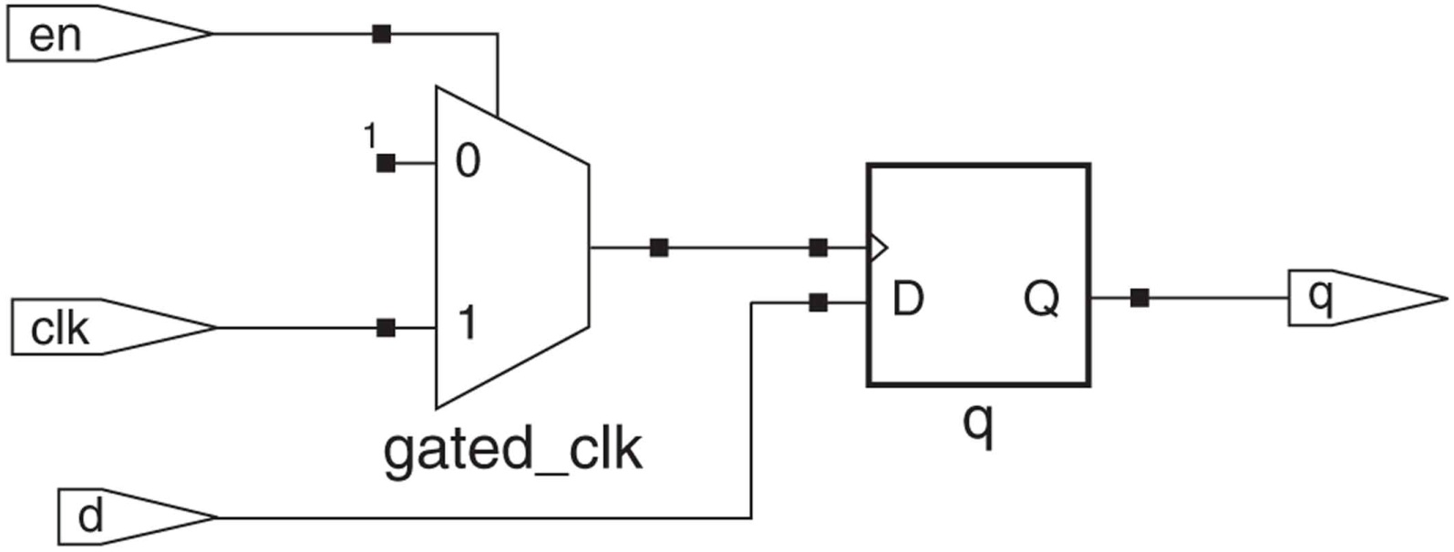
Gated clock flip-flop
Considered a poor design practice
If the signal at the en input has glitches, there is a problem with this approach. Often, this signal is the output of a combinational system, which might produce glitches as its inputs change.
There are situations in the design of low-power circuits where a clock is intentionally gated. In such cases, it is the designer’s responsibility to ensure that the circuit producing the enable signal is glitch free or that the clock is high for a sufficient time for any glitches to have ended.

Slide 22
Gated clock flip-flop
entity d_ff_gated is
port ( d, clk: in std_logic;
en: in std_logic; -- enable input
q: out std_logic);
end d_ff_gated;
architecture behavioral of d_ff_gated is
signal gated_clk : std_logic;
begin
gated_clk <= clk when en = '1' else '1';
process (gated_clk)
begin
if gated_clk'event and gated_clk = '1'
then q <= d;
end if;
end process;
end behavioral;

Slide 23
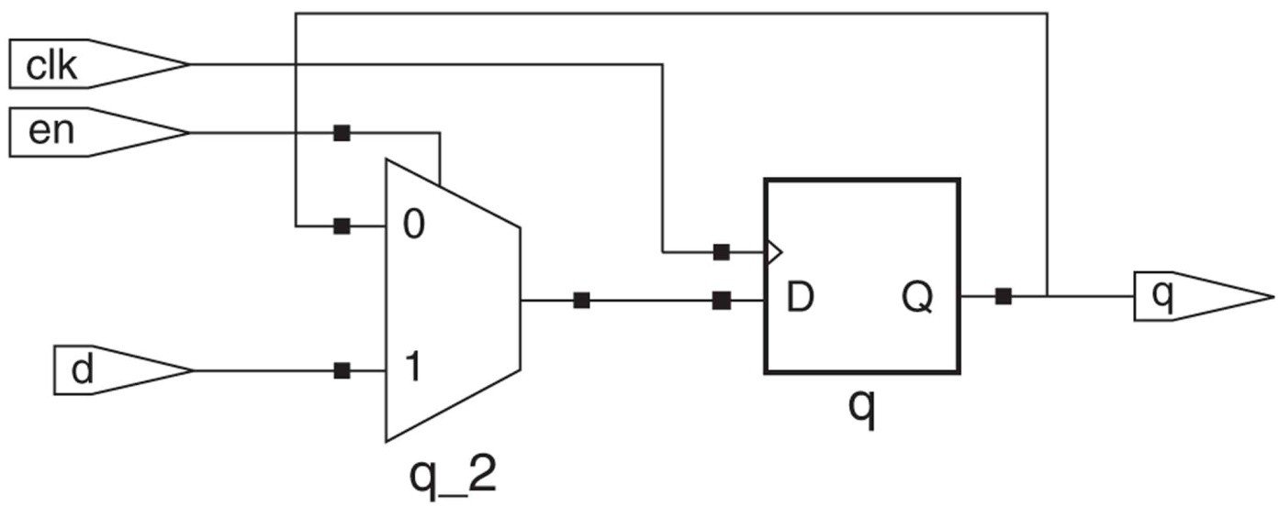
Gated data flip-flop
Glitches on the en input do not affect the state of the flip-flop, as long as en is stable for a time equal to the flip-flop’s setup time prior to the positive edge of the clock. If the enable signal is derived from logic clocked by the same clock, any changes (including glitches) in its value should occur immediately after the positive clock edge. Accordingly, any glitches in the enable signal will have ended long before the setup time of the next triggering clock edge.

Slide 24
Gated data flip-flop
entity d_ff_enabled is
port (d, clk, en: in std_logic; q: out std_logic);
end d_ff_enabled;
architecture behavioral of d_ff_enabled is
signal q_sig : std_logic;
begin
process (clk)
begin
if clk'event and clk = '1' then
if en = '1' then q_sig <= d;
else q_sig <= q_sig;
end if;
end if;
end process;
q <= q_sig;
end behavioral;

Slide 25
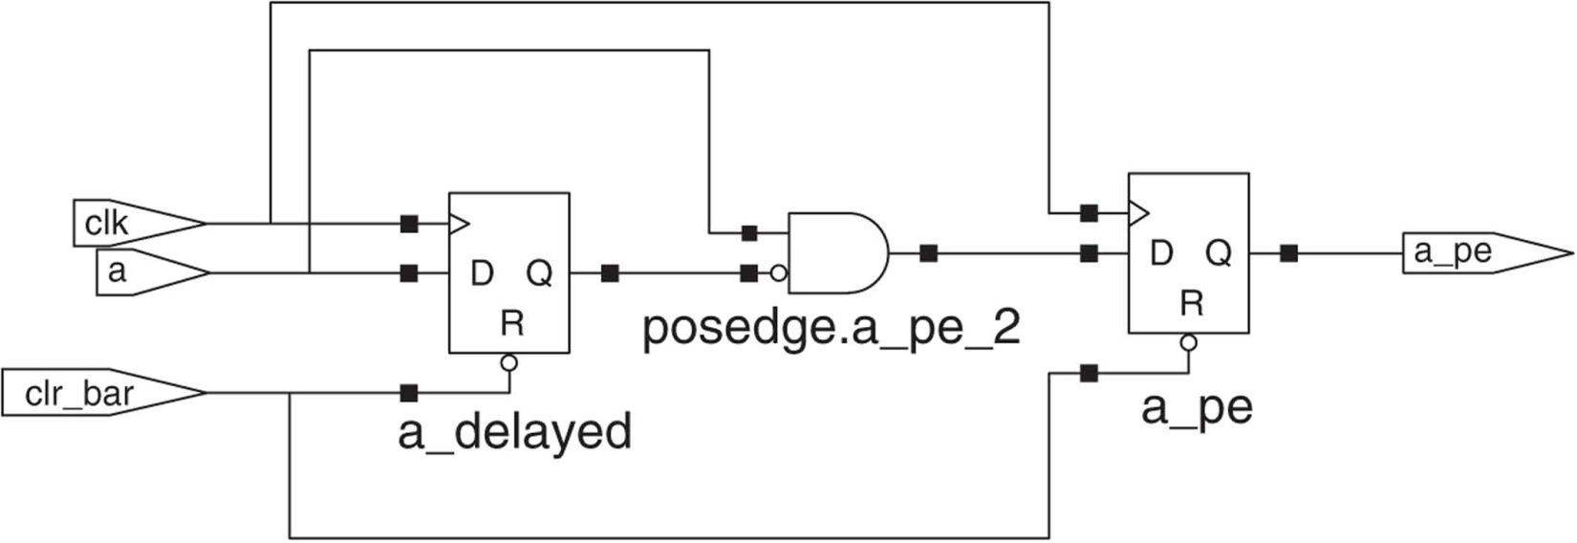
Detecting non–clock signal edges
Often a design requires that some action be carried out when an event occurs on a signal other than the clock signal.
A synchronous edge detector generates a synchronous pulse of one clock duration whenever it detects the required edge of a specified signal.
The objective is to detect positive edges of signal a. To do this, a version of signal a delayed by one clock cycle, called a_delayed, is created. This is done by storing a in a flip-flop at each triggering clock edge.

Slide 26
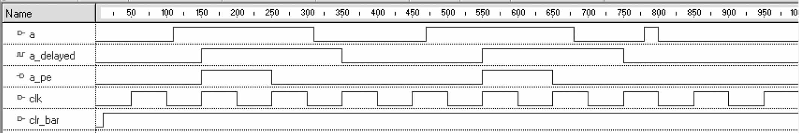
Detecting non–clock signal edges
This edge detector system detects each positive edge of signal a, as long as the positive edge is not part of a narrow pulse that occurs between two adjacent triggering clock edges.
The narrow pulse that occurs just before 800 ns is missed because this pulse occurs between two triggering clock edges (one at 750 ns and the other at 850 ns).

Slide 27
Detecting non–clock signal edges
entity posedge is
port (a : in std_logic; clr_bar : in std_logic; clk : in std_logic;
a_pe : out std_logic);
end posedge;
architecture behavioral of posedge is
signal a_delayed : std_logic;
begin
posedge: process (clr_bar, clk)
begin
if clr_bar = '0' then a_pe <= '0'; a_delayed <= '0';
elsif rising_edge (clk) then a_delayed <= a;
a_pe <= not a_delayed and a;
end if;
end process;
end behavioral;

Slide 28
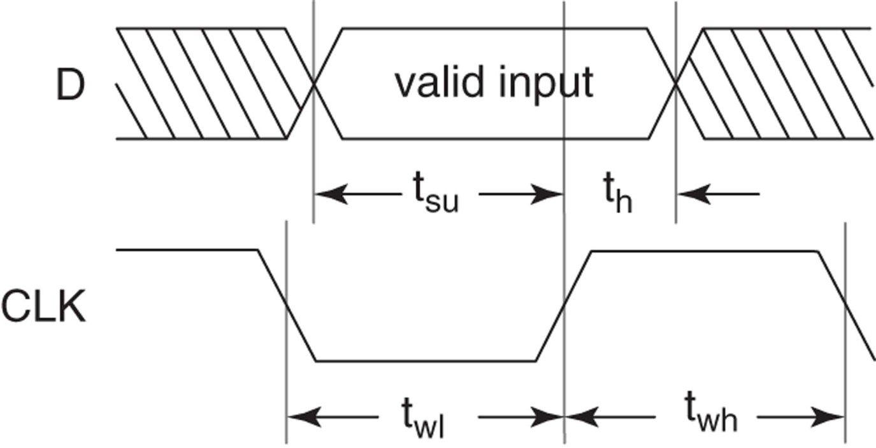
Timing requirements
Physical memory elements have timing requirements that must be met to ensure their proper operation. For example, input data to a D flipflop must be stable for a period of time (setup time, t_{su}) before a triggering clock edge and must remain stable for a period of time (hold time, t_{h}) after a triggering clock edge. There is also a minimum clock width requirement (clock width, t_{wh}) that must be met.

Slide 29
Metastable event Violating Setup Time or Hold Time Requirements
One result of not meeting setup time or hold time requirements is the possibility of a metastable event. The term metastable event denotes the situation where a flip-flop’s output either remains between valid states for an unusually long period of time or fails to complete the transition to the desired state after a triggering clock edge. Metastable events can result in incorrect system operation.

Slide 30
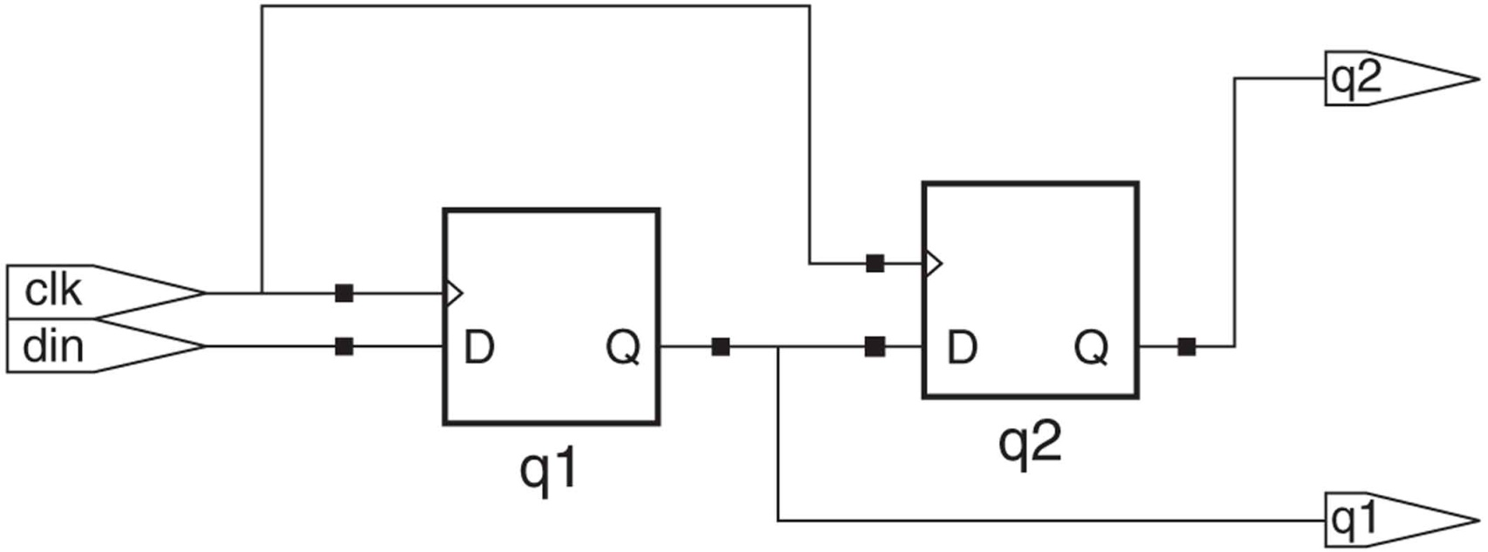
Synchronous input data
If the Q output of one flip-flop provides input data to a second flip-flop that uses the same clock signal, the input data to the second flip-flop is synchronous input data.
With synchronous input data and a sufficiently long clock period it is easy to ensure that a flip-flop’s setup time and hold time requirements are met.

Slide 31
Use of flip-flops versus latches
Generally, the use of latches as simple storage elements is not recommended.
Traditionally, latches had the advantage in custom IC design of requiring fewer transistors, thus requiring half as much IC area. However, latches in FPGAs are typically implemented using memory elements that can be configured as either a latch or flip-flop. The amount of chip area taken by a configurable memory element in a FPGA is fixed, regardless of whether it is configured as a latch or flip-flop. More importantly, use of latches increases the timing complexity of a design. This necessitates much more careful design techniques and timing analysis to ensure correct operation.

Slide 32
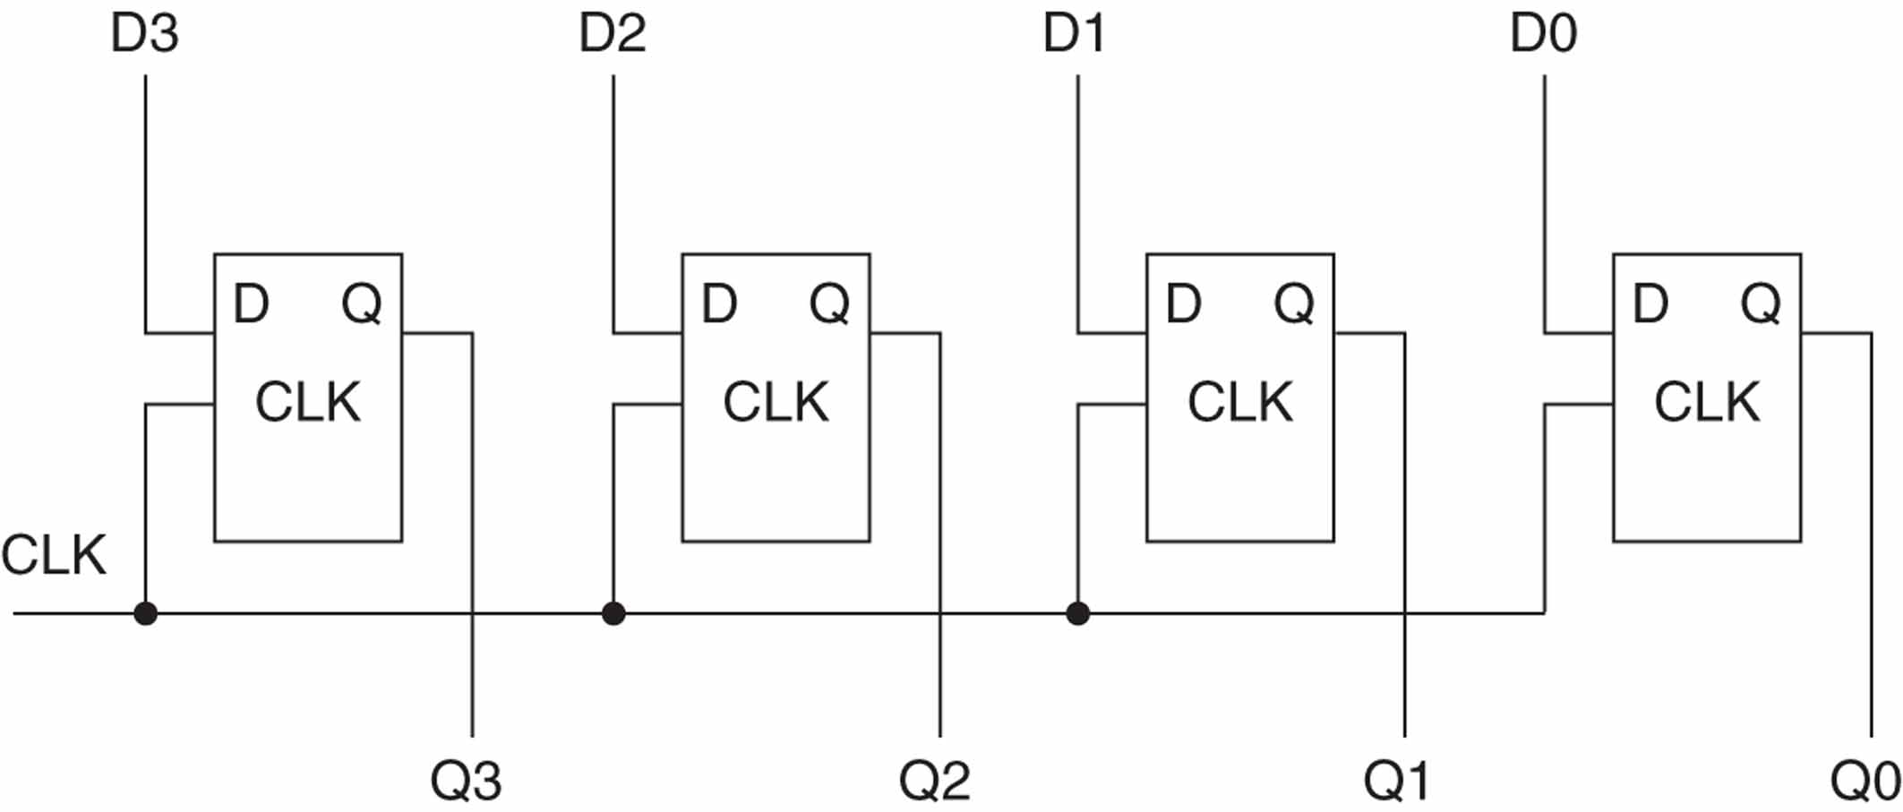
Multibit latches and registers
Either latches or flip-flops can be interconnected to form memory structures that store multiple bits of information as a unit. Flip-flops can also be combined to form shift registers, shift register counters, and counters.

Slide 33
A multibit D latch
entity octal_d_latch is
port (d: in std_logic_vector(7 downto 0);
clk, set_bar, clear_bar: in std_logic;
q: out std_logic_vector(7 downto 0));
end octal_d_latch;
architecture behavioral of octal_d_latch is
begin
process (d, clk, set_bar, clear_bar)
begin
if set_bar = '0' then q <= (others => '1');
elsif clear_bar = '0' then q <= (others => '0');
elsif clk = '1' then q <= d;
end if;
end process;
end behavioral;

Slide 34
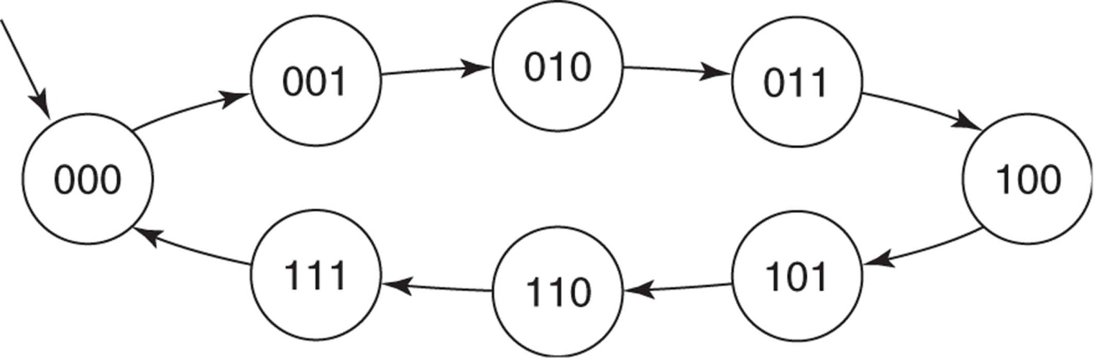
Counters
Counters are simple examples of finite state machines (FSMs).
Counters are used to count events, generate time intervals, generate events, and divide down an input signal to create a lower frequency output signal.
A counter’s next state is the state it goes to from its present state at a triggering clock edge. A simple counter transitions from one unique state to another, until it eventually returns to its initial state, after which its state transitions repeat.
State diagram for a 3-bit counter

Slide 35
Counters
A straightforward approach to the description of a counter involves use of arithmetic operators. For example, an up counter is simply a register whose value is incremented. Incrementing a register is accomplished by adding 1 to its present value.
But in VHDL, addition and subtraction operations are predefined for only the types integer, real, and time. Since we are using std_logic or std_logic_vector types for inputs and outputs, we cannot use the predefined + and – operators directly. Two ways to solve this problem are:
1. Use type integer signals or variables along with the predefined + and – operators, then use functions to convert the integer results to std_logic.
2. Use type unsigned from the package NUMERIC_STD, which also overloads the + and – operators for this type, then convert the unsigned results to std_logic_vector.

Slide 36
Counters
using an integer signal
Signal count_int is declared as type integer with a range of 0 to 15. This range is consistent with that of a 4-bit binary counter. Signal count_int maintains the counter’s value and is incremented by the process at each triggering clock edge. Use of signal count_int is another example of the technique used to read the value assigned to a mode out port.
library ieee;
use ieee.std_logic_1164.all;
use ieee.numeric_std.all;
entity counter_4bit is
port (clk, reset_bar: in std_logic;
count: out std_logic_vector (3 downto 0));
end counter_4bit;
architecture behav_int of counter_4bit is
signal count_int : integer range 0 to 15;
begin

Slide 37
Counters
using an integer signal
cnt_int: process (clk, reset_bar)
begin
if reset_bar = '0' then
count_int <= 0;
elsif rising_edge(clk) then
if count_int = 15 then
count_int <= 0;
else
count_int <= count_int + 1; --read and increment count_int
end if;
end if;
end process;
count <= std_logic_vector(to_unsigned(count_int,4));
end behav_int;

Slide 38
Counters
using an integer signal
Signal count_int is needed for two reasons. First, we want an integer signal so that we can use the predefined + operator. This integer signal is then converted to a std_logic_vector for output. Second, in order to increment this signal, we need to be able to read the present value of the counter. We can’t read that value directly from count, because count is a mode out port.
The concurrent assignment statement
count <= std_logic_vector(to_unsigned(count_int,4));
first uses the function to_unsigned to convert integer signal count_int into a 4-bit unsigned vector. The value returned by this function is then converted to type std_logic_vector and assigned to output count. Since this assignment statement is a concurrent function call, it executes anytime there is an event on the parameter count_int of the function to_unsigned.

Slide 39
Counter
library ieee;
use ieee.std_logic_1164.all;
use ieee.numeric_std.all;
entity counter_4bit is
port (clk, reset_bar: in std_logic;
count: out std_logic_vector (3 downto 0));
end counter_4bit;
architecture behav_us of counter_4bit is
signal count_us : unsigned(3 downto 0);
begin
cnt_us: process (clk, reset_bar)
begin
if reset_bar = '0' then count_us <= "0000";
elsif rising_edge(clk) then count_us <= count_us + 1;
end if;
end process;
count <= std_logic_vector(count_us);
end behav_us;
using unsigned signal
An advantage of using an unsigned type in a binary counter is that we do not have to check whether the count is at its maximum value to force it to 0 on the next count. An unsigned vector naturally rolls over to 0 on the next count after it has reached all 1s or (2^{n} – 1).

